Slide 1

PRESENTED BY :-
JAFAR SHAH (40)

Slide 2
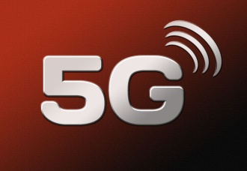
C O N T E N T S
Introduction to 5G.
5G Experience be like.
Brief Idea about 5G.
Evolution from 1G to 5G.
Comparison table of features of 1G to 5G.
Architecture of 5G.
Functional Architecture of 5G.
Hardware and Software of 5G.
Advantages.
Disadvantages.
Applications.
Conclusion.

Slide 3
INTRODUCTION
5G is the short for fifth generation, a mobile broadband technology that is in the early stages of works and likely to be in place six to seven years from now.
A 5G network will be able to handle 10,000 times more call and data traffic than the current 3G or 4G network.
Data download speeds on 5G networks are likely to be several hundred times more than 4G.
5G mobile technology will change the means to use cell phones within very high bandwidth.

Slide 4
BRIEF IDEA ABOUT 5G
CURRENT STATUS OF 5G? The European Telecommunications Standards Institute is formulating 5G global technology standards, which are likely to be formalized by 2019. Telecom companies such as Nokia, Ericsson, NTT DoCoMo, Samsung, Huawei and Fujitsu are driving bulk of the 5G-related innovations.
PEOPLE WILL BE ABLE TO EXPERIENCE WITH 5G. 5G networks are likely to be rolled out commercially between 2020 and 2025. If the global standards are finalized by 2019, the earliest commercial deployments could happen by 2020.
3G AND 4G HANDSETS DOESN’T RUN ON 5G NETWORKS. No. 5G will require new chipsets and devices capable of supporting speeds upwards of 10 gigabits per second. 4G and 3G run at a fraction of that speed.

Slide 5
Evolution from 1G to 5G
1G (1980/1990)
2G/2.5G ( Late 90’S)
3G (2001)
4G (2010)
5G (Expected by 2017 in Indian Market)

Slide 6
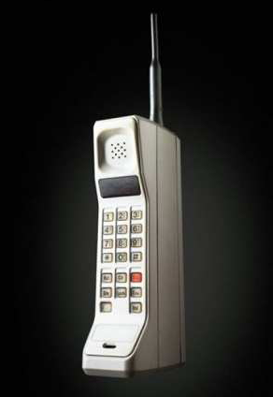
1G:- 1’st Generation
1G refers to 1st generation of mobile
telecommunication
It is developed in 1980s and completed in early 1990s.
It provides a speed up to 2.4kbps.
It is based on analog system.
It allows user to make call in one country.
It has low capacity, unreliable handoff, poor voice links ,
and no security at all since voice calls were played back in radio towers, making these calls susceptible to unwanted eavesdropping by third parties. low capacity, unreliable handoff, poor voice links, and no security a
t all since voice calls were played back in radio towers, making these calls susceptible to unwanted eavesdropping by third parties.
has low capacity, unreliable handoff, poor voice links, and no security at all since voice calls were played back in radio towers, making these calls susceptible to unwanted eavesdropping by third parties.

Slide 7
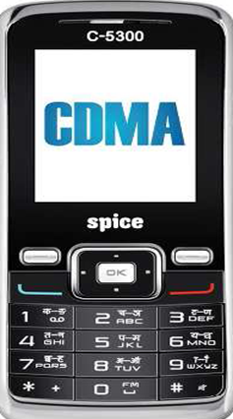
2G :- 2’nd Generation
2G refers to 2nd generation of mobile telecommunication.
It was developed in late 1980s and completed
in late 1990s.
It is based on digital system.
It provides a speed of up to 64 kbps.
It provides services like voice and sms with
more clarity.
Major prominent technologies were GSM, CDMA, and IS95

Slide 8
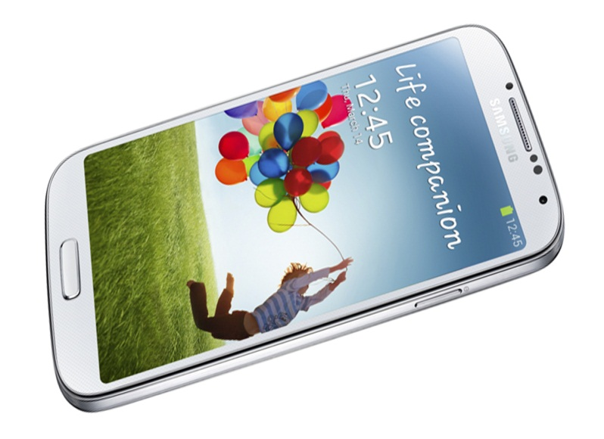
3G :- Third Generation
NTT DoCoMo launched the first commercial 3G network on 1 October 2001, using the WCDMA technology
bandwidth of 3G network is 128 Kbps for mobile stations, and 2 Mbps for fixed applications
The current trend in mobile systems is to support the high bit rate data services at the downlink via High Speed Downlink Packet Access (HSDPA)

Slide 9
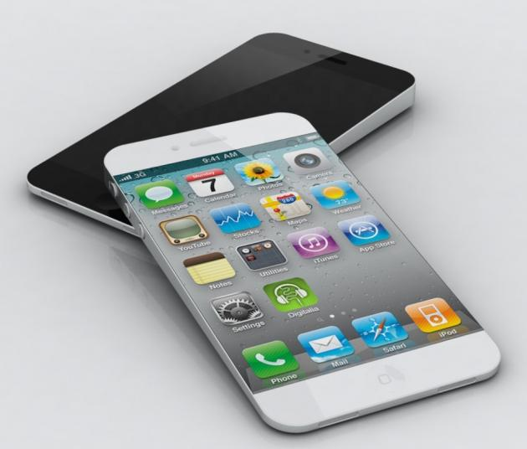
4G:- 4’th Generation
It was developed in the year 2010.
It is faster and more reliable.
It provides speed up to 100mbps.
It provides high performance like uploading and downloading speed.
It provides easy roaming as compaired to 3G.
Use of a higher Layer Protocol (IP) as transport medium affords intelligence at every stage within the network relative to a service

Slide 10
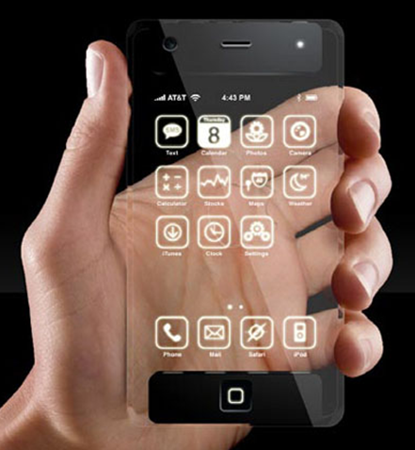
5G :- 5’th Generation
It is the next major phase of mobile telecommunication & wireless system.
It is 10 times more faster than 4G.
It has a expected speed of 1gbps.
Lower cost than the previous version.
It is expected to come around the year 2017.

Slide 11
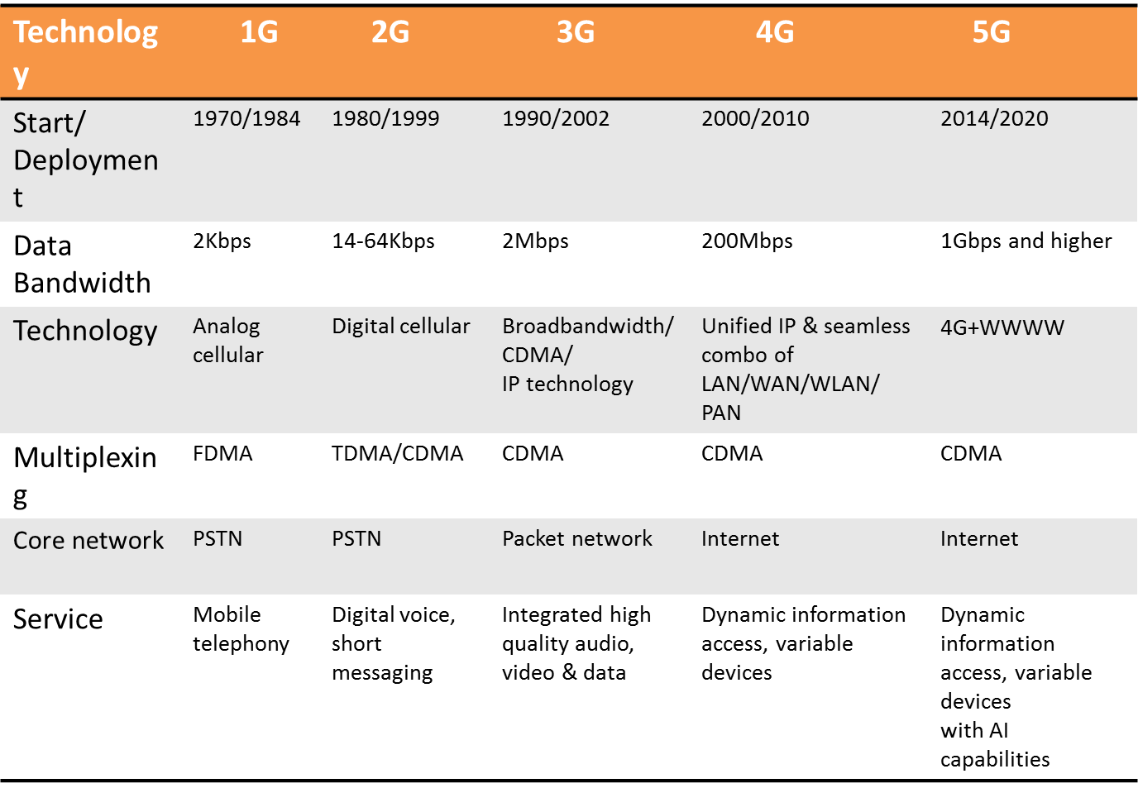
Comparison of 5G with other :-

Slide 12
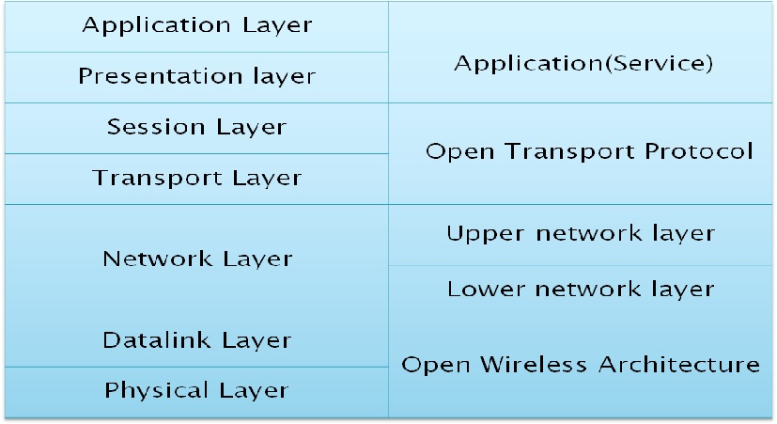
Networking Architecture of 5G:-
OSI Layers 5G mobile network layer

Slide 13
OWA stands for Open Wireless Architecture this layer is used to be used as Physical Layer + Data link Layer = OWA.
Network Layer is divided into two sub layers
1) Lower Network Layer
2) Upper Network Layer
Network Layer is used to route the data from source to destination.
Open transport layer perform the operation of both Transport Layer and Session Layer.
Transport Layer + Session Layer=OTL.
Application Layer marks the data into proper format i.e. ,it decrypt the data which is in encrypted form and selects the best wireless connection for a given service.

Slide 14
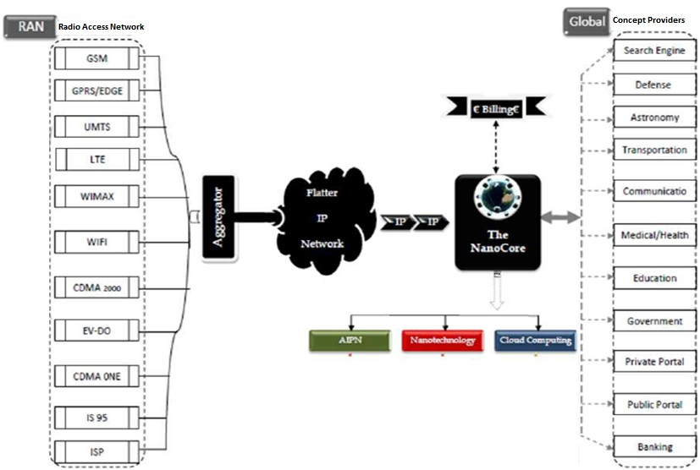
DATA TRANSFER ARCHITECHTURE OF 5G

Slide 15
RAN
A radio access network (RAN) is part of a mobile telecommunication system. It implements a Radio Access Technology. Conceptually, it resides between a device such as a mobile phone, a computer, or any remotely controlled machine and provides connection with its core network.
FLAT IP NETWORK
Certainly Flat IP network is the key concept to make 5G acceptable for all kind of technologies. To meet customer demand for real-time data applications delivered over mobile broadband networks, wireless operators are turning to flat IP network architectures.
5G NANOCORE
The 5G Nanocore is a convergence of below mention technologies. These technologies have their own impact on exiting wireless network which makes them in to 5G.
Nanotechnology.
Cloud Computing.
All IP Platform.

Slide 16
Nano Technology :-
Nanotechnology is the application of nano science to control process on manometer scale. i.e. between 0.1 and100nm.The field is also known as molecular nanotechnology(MNT). It deals with control of the structure of matter based on atom-by-atom and molecule by molecule engineering. The term nanotechnology was introduced by Nori Taniguchi in 1974 at the Tokyo international conference on production engineering.
Cloud computing :-
Cloud computing is a technology that uses the internet and central remote server to maintain data and applications. In 5G network this central remote server will be our content provide. Cloud computing allows consumers and business to use applications without installation and access their personal files at any computer with internet access. The same concept is going to be used in Nanocore where the user tries to access his private account form a global content provider through Nanocore in form of cloud.
The All-IP Network(AIPN) :-
The All-IP Network(AIPN) is an evolution of the 3GPPsystem to meet the increasing demands of the mobile telecommunications market. To meets customer demand for real-time data applications delivered over mobile broadband networks, wireless operators are turning to flat IP network architectures.

Slide 17
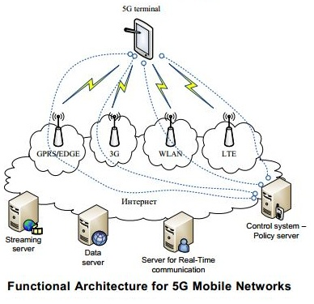
FUNCTIONAL ARCHITECTURE OF 5G

Slide 18
GPRS (General Packet Radio Service)
a) It is used to transmit data at 60kb/sec.
b) It consume less battery during sending & receiving mail or . . . . browsing internet.
EDGE (Exchanged Data Rate for GSM Evolution)
a) It is an advance version of GPRS .
b) It provide a data speed of 473kb/sec.
3G
a) 3G makes it possible to do video call on mobile network.
b) It also provide efficient way to browse internet on mobile networking.
WLAN( Wireless LAN)
a) Wireless LAN provides short range, high speed wireless data . . connection between mobile data device using radio or signal.
LTE(Long Term Evolution)
a) LTE is standard for mobile communication for high speed data
transmission for mobile network. Its Speed is up to 100mb/sec.

Slide 19
Principle Of Data Transmission :-
In 5G mobile IP, each cell phone is expected to have a permanent "home" IP address, along with a "care-of" address that represents its actual location.
IPv6 is needed for many addresses and the multiple layers of sub netting.
128 bits (4 times more than current 32 bit IPv4 address) may be divided into four parts (I thru IV) for supporting different functions. The first 32-bit part (I) may be defined as the home address of a device while the second part (II) may be declared as the care-of address allowing communication between cell phones and personal computers.

Slide 20
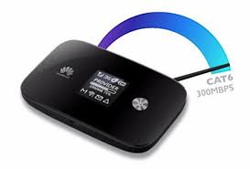
Hardware Used in 5G :-
HARDWARE USED :-
Uses UWB (Ultra Wide Band) networks with higher BW at low energy levels.
BW is of 4000 Mbps, which is 400 times faster than today’s wireless networks
Uses smart antenna
Uses CDMA (Code Division Multiple Access)

Slide 21
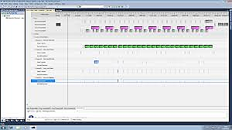
Software Used in 5G :-
SOFTWARE USED
5G will be single unified standard of different wireless networks, including LAN technologies, LAN/WAN, WWWW- World Wide Wireless Web, unified IP & seamless combination of broadband
Software defined radio, encryption, flexibility, Anti-Virus

Slide 22
ADVANTAGES :-
Data Bandwidth of 1Gbps or higher.
Dynamic information access.
Available at low cost.
Finest Quality Of Service(QOS).
Pages will upload almost instantly.
Support interactive multimedia, voice, streaming video, Internet, and other broadband services.

Slide 23
DISADVANTAGE :-
Since 5G services are likely to run on ultra-high spectrum bands, which
travel shorter distances compared with lower bands, they may be more
suited to enhanced indoor coverage.
Higher frequencies could be blocked by buildings and they lose intensity
over longer distances. That means, offering wider coverage would be a
challenge.

Slide 24
APPLICATIONS
Wireable devices with AI(Artificial Intelligence)capabilities.
5G iPhones.
With 6th Sense technology.
Global Networks.
VoIP(Voice Over IP) enabled devices.
Radio resource management.
Media independent handover.

Slide 25
CONCLUSION
5G technology is going to be a new revolution in wireless systems
market.
5G will be User Centric.
5G is the next frontier of innovation for entire mobile industry.
5G - a promising Generation of wireless communication that will
change people’s lives.

Slide 26

Any queries

